Slide 1
Smart Vacuum Cleaner
Presented by:
Ahmed Shoud : 18.02.04.083
Md. Ashfaqur Rahman : 18.02.04.110
Tajrian Islam Ishan : 18.02.04.111
Asifur Rahman Asif : 18.02.04.114

Slide 2
Table of Contents
1
3
2
4
Objective
Required Components
Social Values
Working Procedure

Slide 3
Table of Contents
5
7
6
Features
Conclusion
Estimated Budget

Slide 4
Objective:
In this project we will use the power of Embedded Systems and Electronics to make our own robot which could help us in keeping our home or work place neat and tidy besides its less costly and less power consuming than other cleaning robots.

Slide 5
Social Values :
Ease of Use
Hands-free Operation
Low Maintenance
Save your time & energy
Vacuum under tough spots

Slide 6
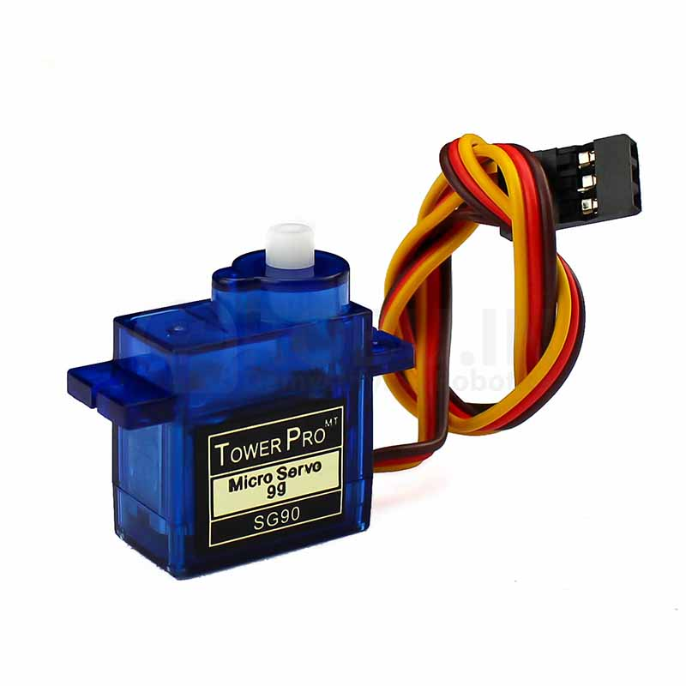
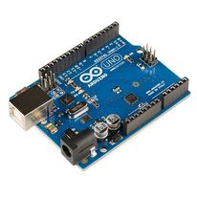
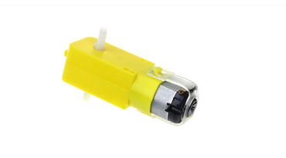
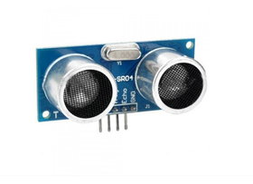
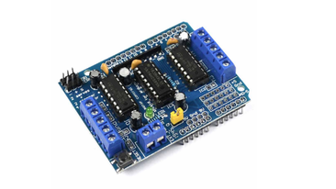
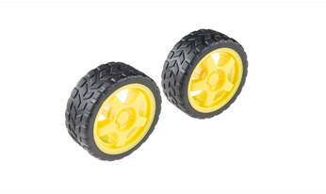
Required Components
Arduino Uno
Servo Motor
Gear Motor
Robot Wheel
Motor Driver Shield
Ultrasonic Sensor

Slide 7
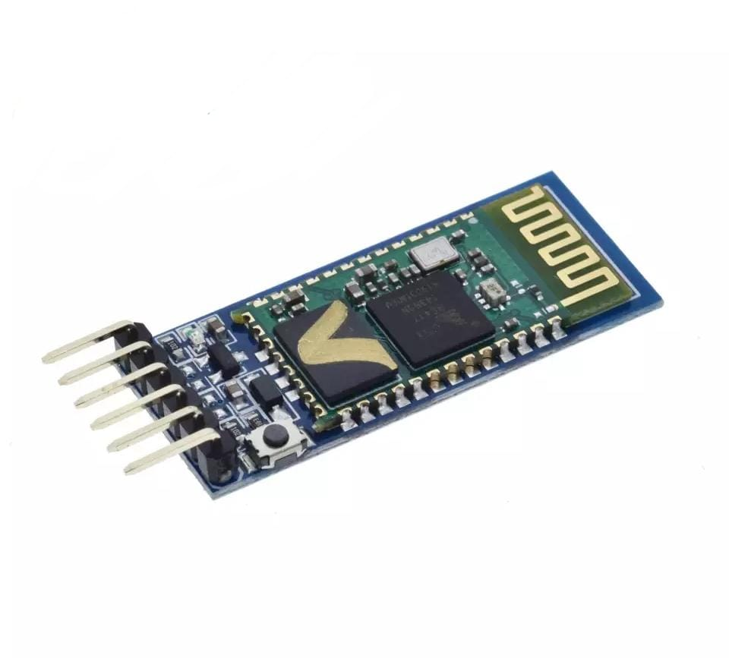
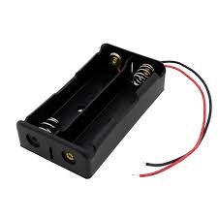
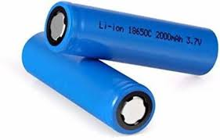
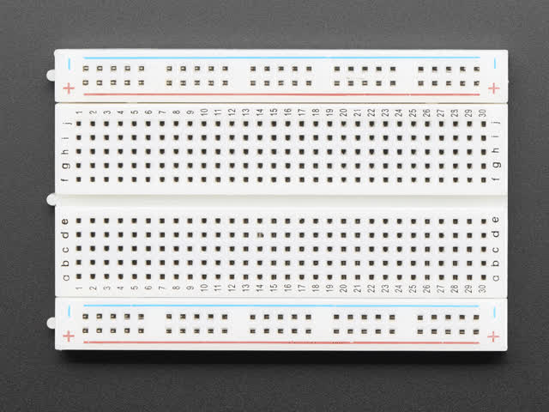
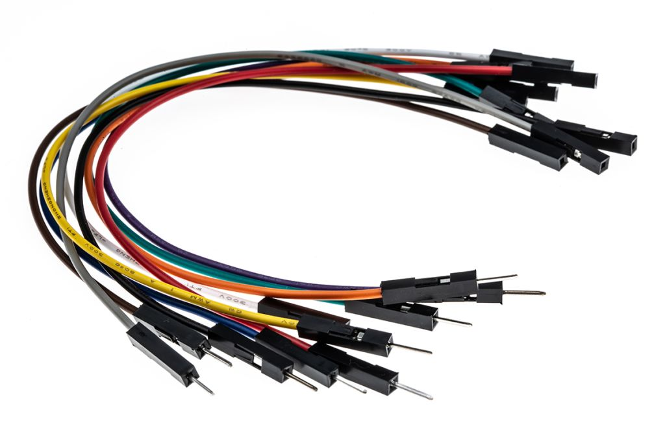
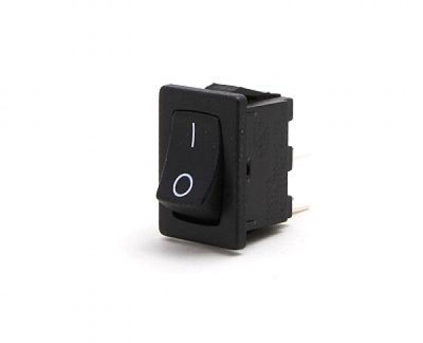
Required Components:
Bluetooth Module
Li-ion Battery
Li-ion Battery Holder
Breadboard
Jumper Wires
ON/OFF Switch

Slide 8
Working Procedure:
Arduino Uno:
The Arduino Uno is an open-source microcontroller board based on the Microchip ATmega328P microcontroller and developed by Arduino.cc. The board is equipped with sets of digital and analog input/output (I/O) pins that may be interfaced to various expansion boards (shields) and other circuits.
Arduino Uno

Slide 9
Working Procedure:
Motor Driver Shield:
The Motor Shield is a driver module for motors that allows you to use Arduino to control the working speed and direction of the motor.
Motor Driver Shield

Slide 10
Working Procedure:
Ultrasonic Sensor:
An ultrasonic sensor is an instrument that measures the distance to an object using ultrasonic sound waves. An ultrasonic sensor uses a transducer to send and receive ultrasonic pulses that relay back information about an object's proximity.
Ultrasonic Sensor

Slide 11
Features :
Obstacle Avoiding
Garbage Collection
Bluetooth Control
Voice Control

Slide 12
Estimated Budget :
Equipment | Quantity | Budget(TK)
Arduino Uno R3 | 1 | 681
Gear Motor | 4 | 300
Wheel (Rubber Tire) | 4 | 256
L293D DC Motor Driver Shield | 1 | 230
Sonar Sensor HC-SR04 | 1 | 110
Bluetooth Module Breakout (HC-05) | 1 | 366
Rechargeable 6800mAh Li-ion Battery | 2 | 100
Battery Holder | 1 | 50
Breadboard Jumper Wire Set | 1 | 156
Breadboard | 1 | 50
Dip Switch | 1 | 15
Garbage Collector | 1 | 20
Servo Motor SG90 | 1 | 200
DC Fan 12V | 1 | 66
Total |  | 2600

Slide 13
Conclusion :
In this project we will implement Smart Vacuum Cleaner. Whenever Robot Vacuum car encounters any obstacle, it turns to the side where the distance between obstacle and car is more. This project helps collect the dust using a vacuum cleaner made using daily useable tools and batteries without human intervention thereby reducing the hazards to human health.

Slide 14
Thanks! Any Questions??

